Slide 1
An approach for Security Testing of Web Applications

Slide 2

Introduction
As more and more vital data is stored in web applications and the number of transactions on the web increases, proper security testing of web applications is becoming very important.
Security testing is the process that determines that confidential data stays confidential (i.e. it is not exposed to individuals/ entities for which it is not meant) and users can perform only those tasks that they are authorized to perform.

Slide 3

Some key terms used in security testing
Before we go further, it will be useful to be aware of a few terms that are frequently used in web application security testing:
What is “Vulnerability”? This is a weakness in the web application. The cause of such a “weakness” can be bugs in the application, an injection (SQL/ script code) or the presence of viruses. What is “URL manipulation”? Some web applications communicate additional information between the client (browser) and the server in the URL. Changing some information in the URL may sometimes lead to unintended behavior by the server.
What is “SQL injection”? This is the process of inserting SQL statements through the web application user interface into some query that is then executed by the server.
What is “Cross Site Scripting”? When a user inserts HTML/ client-side script in the user interface of a web application and this insertion is visible to other users, it is called Cross Site Scripting.

Slide 4
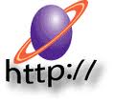
Security Testing Approach
In order to perform a useful security test of a web application, the security tester should have good knowledge of the HTTP protocol. It is important to have an understanding of how the client (browser) and the server communicate using HTTP.
The tester should at least know the basics of SQL injection and Cross Site Scripting.
The tester should be able to accurately describe the security defects with all the required details.

Slide 5
1. URL Manipulation through HTTP GET Method:
The tester should check if the application passes important information in the query string. This happens when the application uses the HTTP GET method to pass information between the client and the server. The information is passed in parameters in the query string. The tester can modify a parameter value in the query string to check if the server accepts it.
Via HTTP GET request user information is passed to server for authentication or fetching data. Attacker can manipulate every input variable passed from this GET request to server in order to get the required information or to corrupt the data.

Slide 6
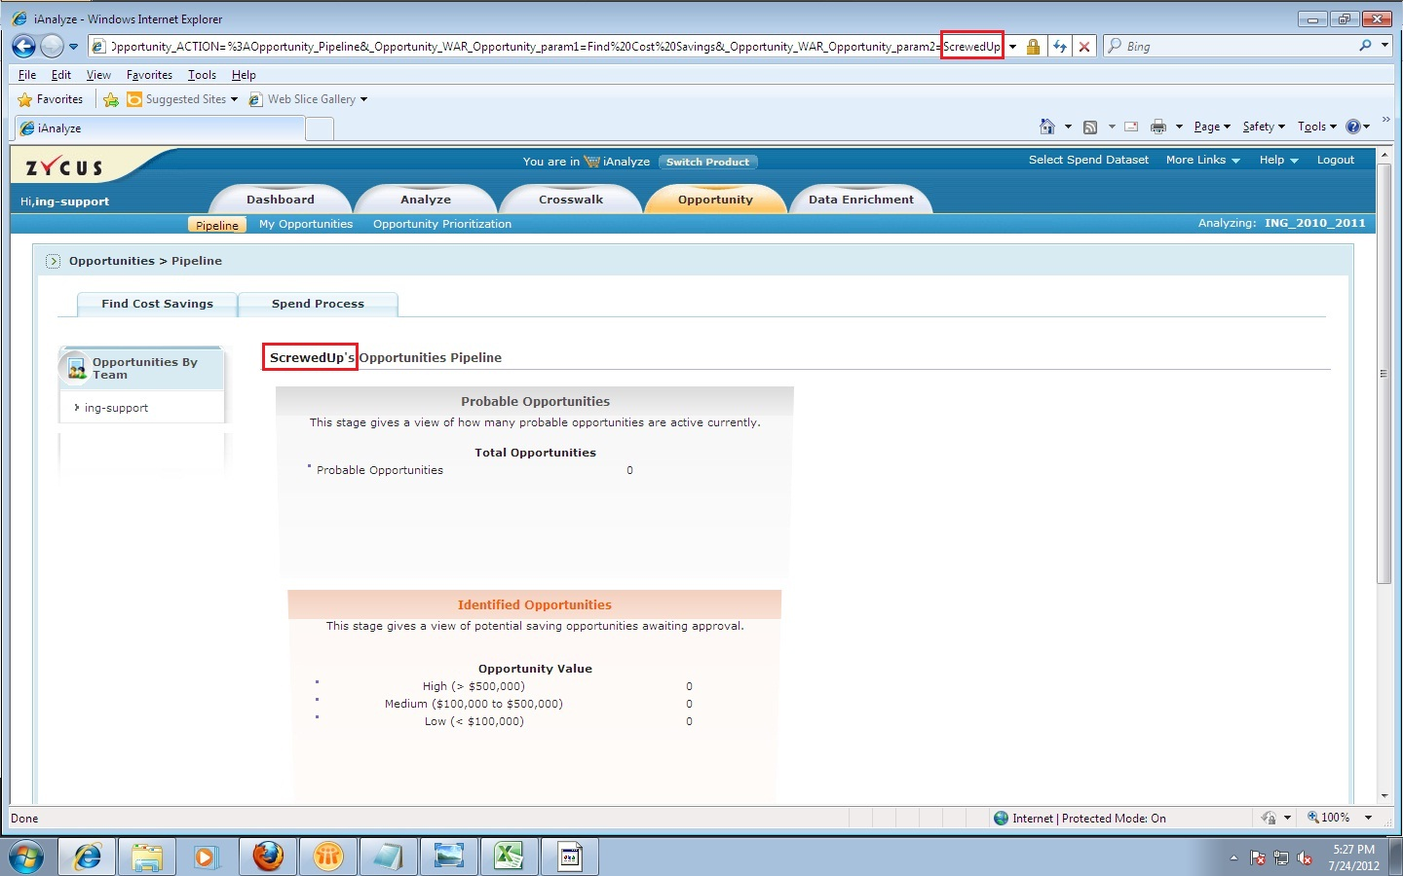
Check whether URL Manipulation and Tampering is handled across application.

Slide 7
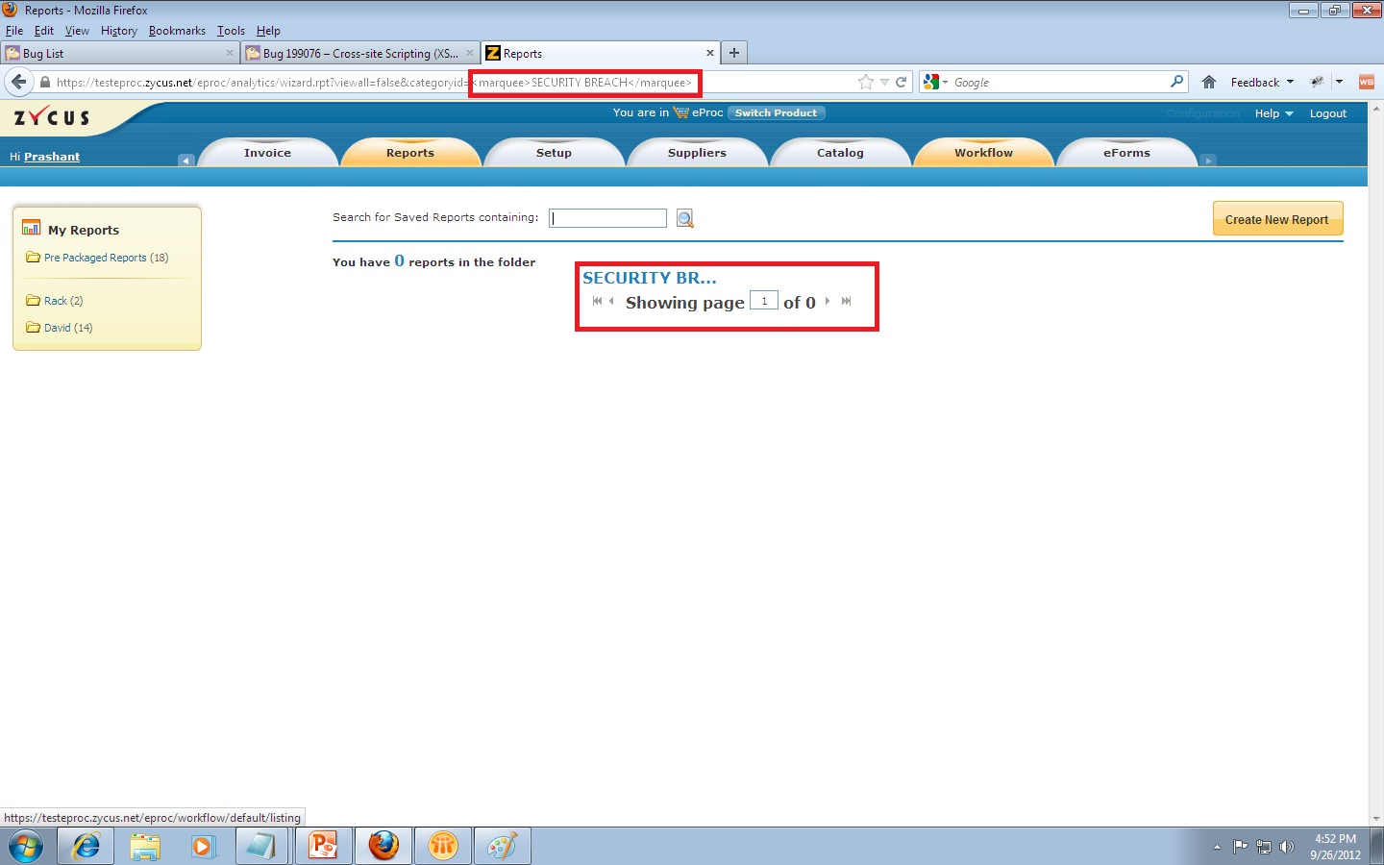
Check whether scripts and HTML tags are not getting executed by replacing the parameters with scripts and HTML tags in the URL.

Slide 8
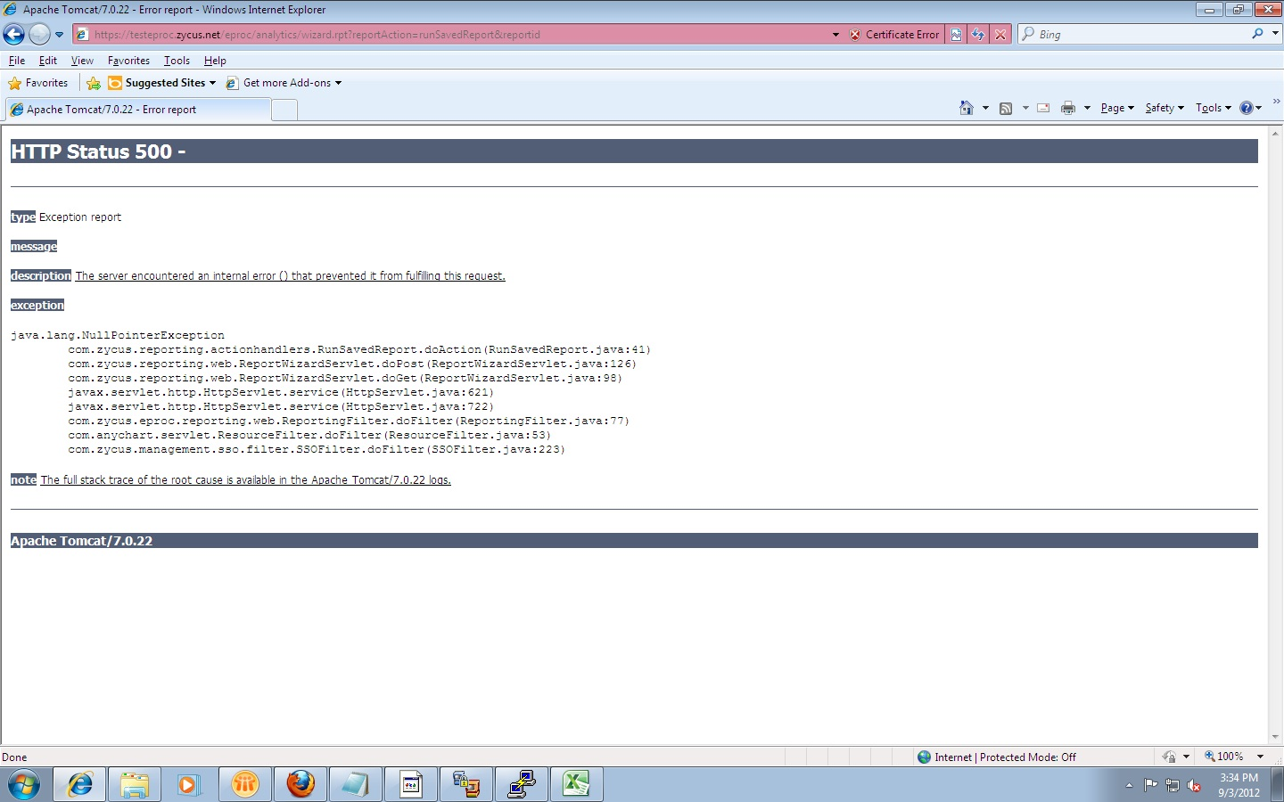
Check whether Internal Server Error or Logs are not getting displayed when the web server is attempting to display an HTML page.

Slide 9

2. SQL Injection:
SQL injection attacks are very critical as attacker can get vital information from server database. To check SQL injection entry points into your web application, find out code from your code base where direct MySQL queries are executed on database by accepting some user inputs.
If user input data is crafted in SQL queries to query the database, attacker can inject SQL statements or part of SQL statements as user inputs to extract vital information from database.
Exploiting “SQL Injection Attack”

Slide 10
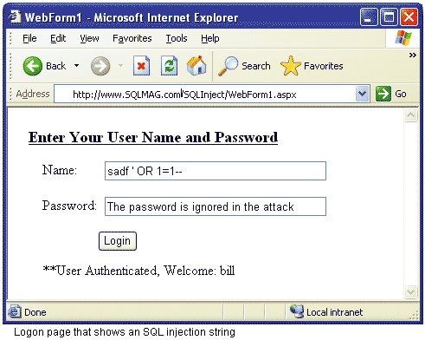
SQL Injection should be handled across application in text areas, text boxes and comment pop ups.

Slide 11
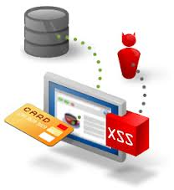
3. Cross Site Scripting :
The tester should additionally check the web application for Cross site scripting. Any HTML e.g. <HTML> or any script e.g. <SCRIPT> should not be accepted by the application. If it is, the application can be prone to an attack by Cross Site Scripting.
Attacker can use this method to execute malicious script on victim’s browser. Using cross-site scripting, attacker can use scripts like JavaScript to steal user cookies and information stored in the cookies.

Slide 12
To Avoid Cross Site Scripting
Check for Unescaped Special characters within input strings.
E.g.: < > " ' % ; ) ( & + -
Check for HTML Character Filtering – Proper handling of special characters
> &gt;
< &lt;
“ &quot;
& &amp;

Slide 13
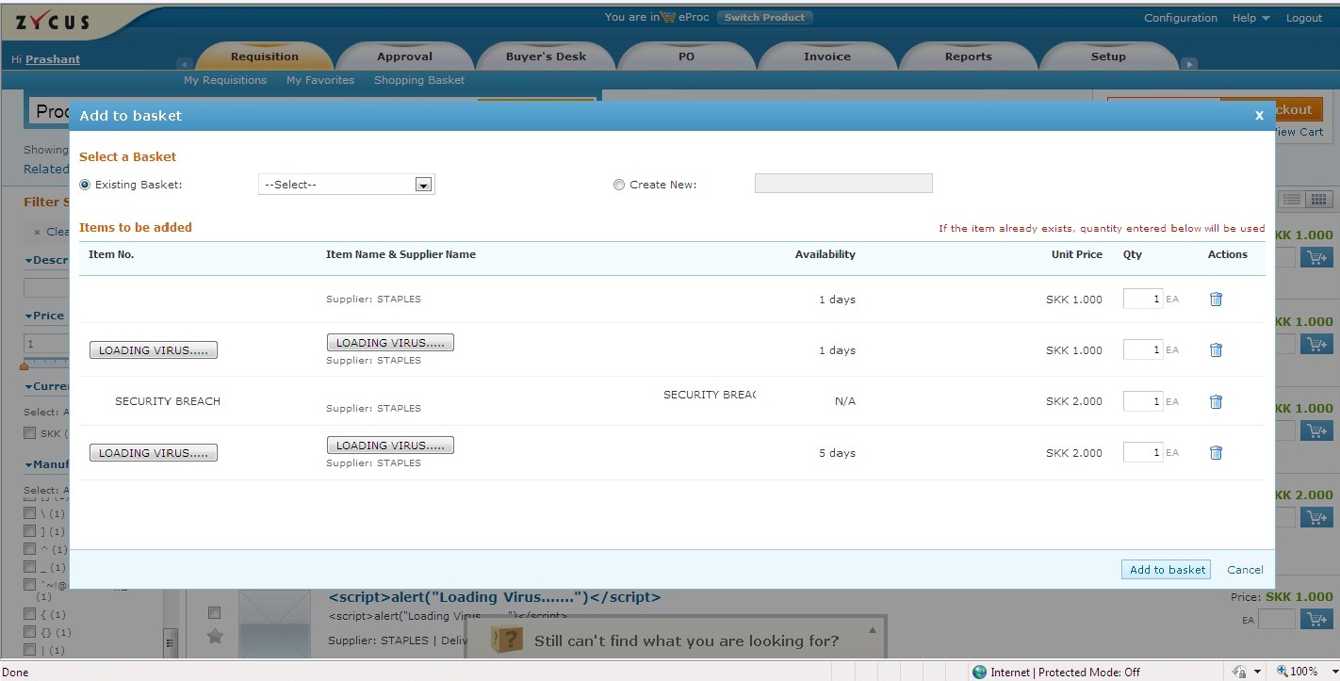
Scripts and HTML tags should be handled across application in text areas, text boxes and comment pop ups

Slide 14
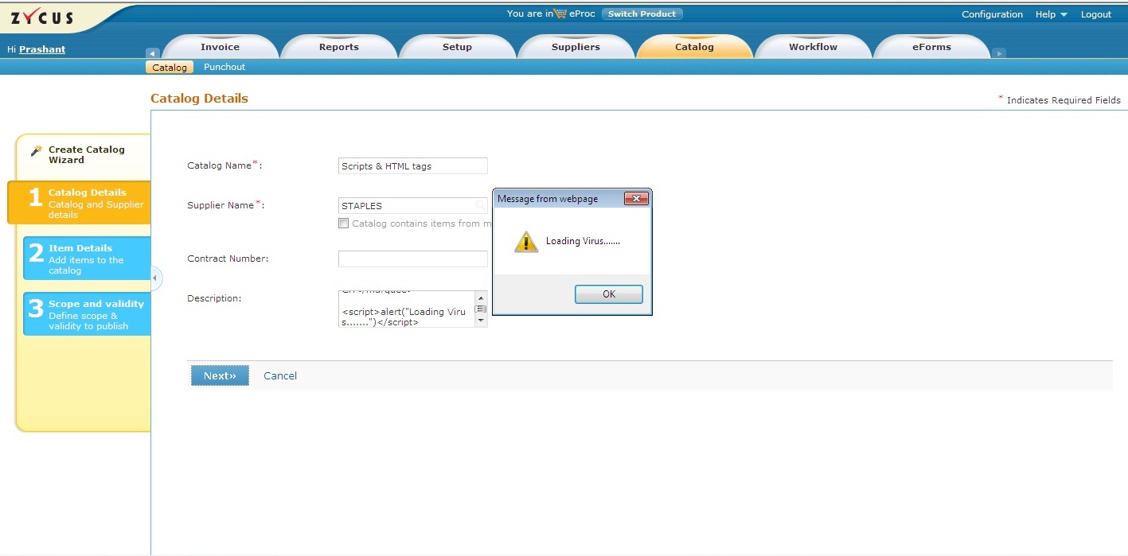
Multiple scripts and HTML tags should be handled across application in text areas, text boxes and comment pop ups.

Slide 15
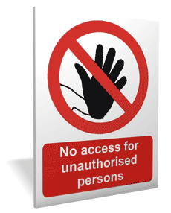
4. Unauthorized Access
Unauthorized access would mean any kind of access without the permission of either the rightful owner or the person in charge.
The popular term for this is “HACKING”
One way of getting unauthorized access is through URL manipulation

Slide 16
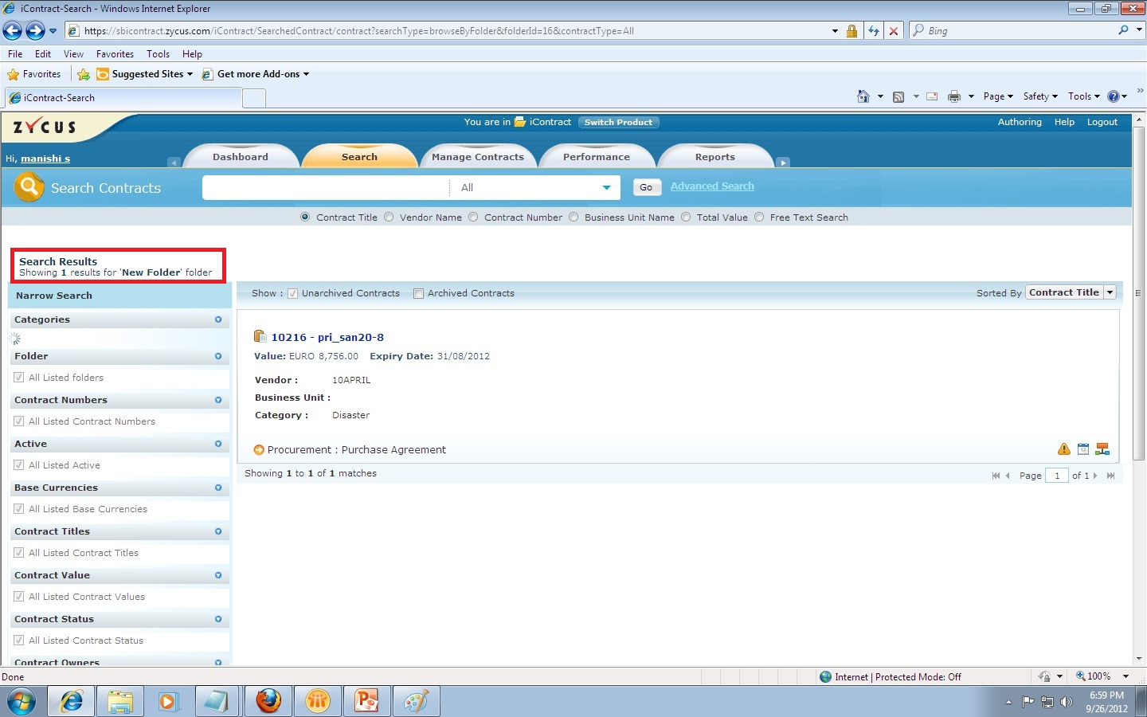
Check whether Unauthorized Access is granted to the user on Manipulating the URL

Slide 17

SQL Inject Me
SQL Inject Me is the Exploit-Me tool used to test for SQL Injection vulnerabilities. The tool works by submitting your HTML forms and substituting the form value with strings that are representative of an SQL Injection attack. The tool works by sending database escape strings through the form fields. It then looks for database error messages that are output into the rendered HTML of the page. The tool does not attempting to compromise the security of the given system. It looks for possible entry points for an attack against the system. There is no port scanning, packet sniffing, password hacking or firewall attacks done by the tool. You can think of the work done by the tool as the same as the QA testers for the site manually entering all of these strings into the form fields.

Slide 18

Websecurify
Websecurify is a powerful, cross-platform web security testing technology designed from the ground up with simplicity in mind.
Websecurify Firefox Extension brings the power of the Websecurify Automated Web Application Vulnerability Discovery Engine right into your Mozilla Firefox web browser. This extension is useful to anyone who wants to quickly assess the security of their own web applications. It is suitable for experts and casual users alike. The user interface is simple and intuitive and the generated reports include complete vulnerability descriptions and examples.

Slide 19
The following vulnerabilities are detected by Websecurify: • SQL Injection • Cross-site Scripting • Cross-site Request Forgery • Email Disclosure • SQL Error • File Upload • WWW Authentication • Banner Disclosure • Session Cookie not HTTP Only • IP Disclosure • Session Cookie not Secure • Path Disclosure • Error Disclosure • User Disclosure • Source Leakage This is a "must-have" tool for all web developers and penetration testers involved with frequent web assessments.

Slide 20
THANK YOU….

